Slide 1
Meta Advertisement Revenue
Presented by:
Soham Ghorpade
GitHub: Soham Ghorpade

Slide 2
Research Question
How much will a company spend on advertising for the next financial year?
What platform will the company use to reach out to potential customers?
How to set the target audience based on age, region, sex?
Approximately how much Ad revenue will Meta generate from next year?

Slide 3
Motivation
As someone who is passionate about finance and economics, I am particularly interested in understanding how Facebook's ad revenue and financial data can be leveraged to create value for users and advertisers.
The opportunity to work on cutting-edge technology and analytics that have a real-world impact on businesses and individuals is a big motivation for me
I find the challenge of analyzing large amounts of data to be both intellectually stimulating and rewarding, particularly when it leads to actionable insights that can drive business growth
It will help me to learn more about adversiting industry and the social and encomical impact which will lead to generating more revenue.

Slide 4
Dataset
Facebook Ad Library Report Rows: 483,517 Columns: 5 (Page Id, Page Name, Disclaimer, Amount spend and Number of ads in library)
More data will be gathered using python, Facebook api and json which include parameters like he age and gender breakdowns, start and end date of the ad, the impression of the ad, money spent and the platform of the ad.
Total number of ads in the Ad Library 14,931,821. Total amount spent $3,800,949,926 (social issues, elections or politics since May 2018)
Facebook’s ad revenues in 2022 hit $113.6 billion. From 2015 to 2021, ad revenue’s average annual growth rate is 36.7%.

Slide 5
Litreature Review
The Impact of Online Advertisement on Building a Brand and on Purchase Intention
Sentiment Analysis to Measure Celebrity Endorsement’s Effect using Support Vector Machine Algorithm
Goal: The study examines the impact of online advertisements on building a brand and on purchase intention
Descriptive correlational analysis is to describe relationships between variables
The researchers used the standard deviation and other factors to determine the brand loyalty and intension of purchase were found to have significant positive effect on purchase intention.
Results: The survey predicted brand loyalty increases by 0.234 for every one unit increase in electronic word of mouth and purchase intention increases by 0.169 for every one unit
Article Link: https://al-kindipublisher.com
Goal: Measure how celebrity endorsement affects the sales of the product
Sentiment analysis was done using SVM algorithm
Results: SVM algorithm predicted the change in Sentiment proportions before and after celebrity endorsement. Sentiment proportions before celebrity endorsement were 71% neutral, 17% negative, and 12% positive. While the details of sentiment proportions after celebrity endorsement were 40% neutral, 42% negative, and 18% positive. Results showcased the importance of age factor
Article Link: https://core.ac.uk

Slide 6
Litreature Review
How Algorithms Shape the Distribution of Political Advertising: Case Studies of Facebook, Google, and TikTok
How Machine Learning Artificial Intelligence Improves Users’ Perceptions of Facebook
Goal: How to improve disclosure of information so that the public can hold platforms and political advertising agencies responsible
They begin by calculating the frequency of political advertisements on the platforms. then calculated the number of impressions for political advertisements on Facebook, Google, and YouTube, as well as the cost to place this content. Using the three analytical criteria, determined whether the data provided by the online platforms adequately explains the platforms' decisions and algorithms.
Results: They assessed what the platform disclosures might reveal to the public about their role in the distribution and moderation of political advertising.
Article Link: https://arxiv.org
Goal: Improve Users’ Perceptions of Facebook using Machine Learning Artificial Intelligence
Integrated model was established to study the relationships between nine variable.
Purchase intent, advertising value, informativeness of advertisements, credibility of advertisements, entertaining quality of advertisements, irritating quality of advertisements, advertising personalization, active use of Facebook, and finally open use of Facebook were the nine variables.
Five-point scale was used to give weightage to variable
Results: The integrated model discovered relationships between variables, implying that machine learning artificial intelligence plays a critical role in making Facebook advertising effective from a commercial standpoint
Article Link: https://etd.ohiolink.edu

Slide 7
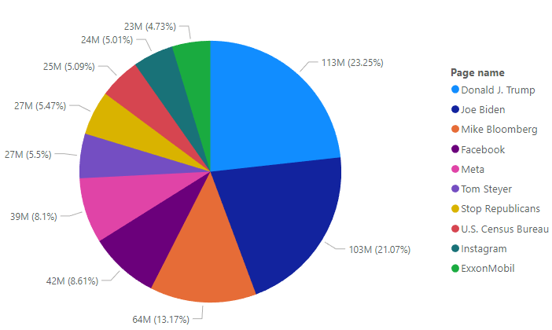
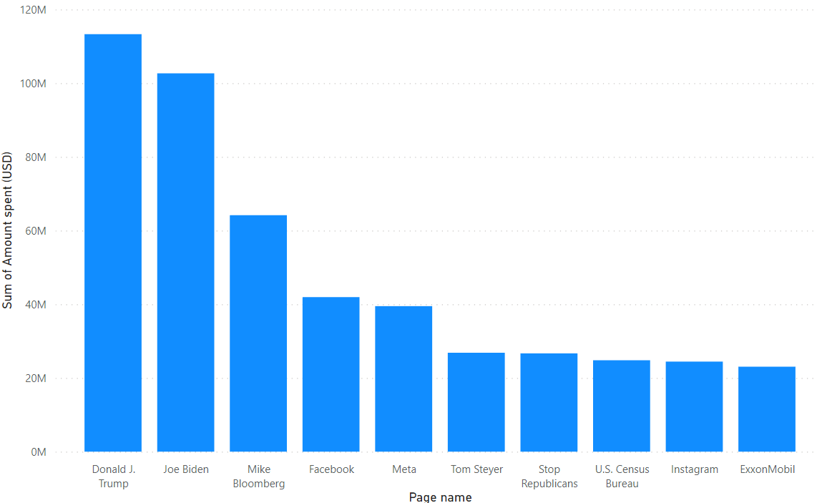
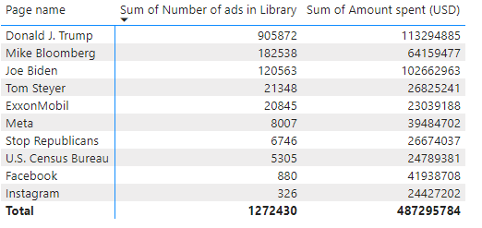
Exploratory Data Analysis
MERCURY
MARS
VENUS
Mercury is the smallest planet
Despite being red, Mars is a cold place
$ 4 Billion

Slide 8
THANK YOU

